Slide 1
Advance ML Using Python
Manaranjan Pradhan
A Data Enthusiast
LinkedIn: https://www.linkedin.com/in/manaranjanpradhan
He writes blogs at www.awesomestats.in

Slide 2
Complete the following steps...
Create a working directory on your desktop / laptop, where you can store all data and the programs of this workshop
Download tutorials and datasets from the link below and store in the above directory
https://github.com/manaranjanp/MLDL3Days
Download the complete repository as zip file and unarchive it
Install latest Anaconda Distribution for Python (3.8+) on your desktop / laptop
https://www.anaconda.com/download/

Slide 3

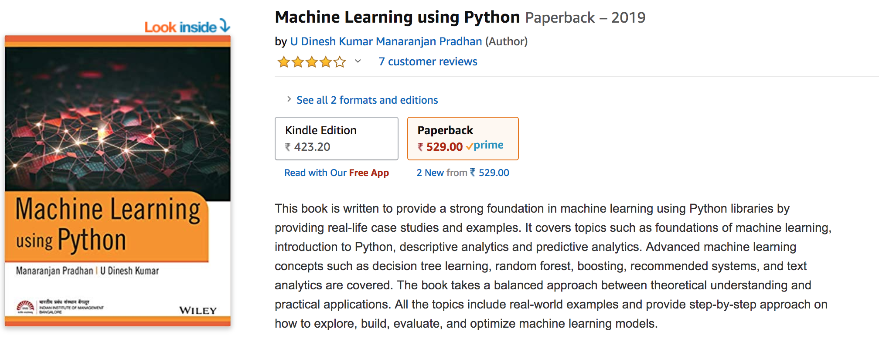
About Me
Has about 21+ years of experience in Industry and Academics
Adjunct Faculty for IIM Bangalore and ISB Hyderabad
Mostly conduct workshops on Spark, Databricks, Machine Learning and Deep Learning
https://www.linkedin.com/in/manaranjanpradhan
Manaranjan Pradhan (Manu)
https://www.amazon.in/Machine-Learning-Python-Manaranjan-Pradhan-ebook/dp/B07RLQPNRX/

Slide 4
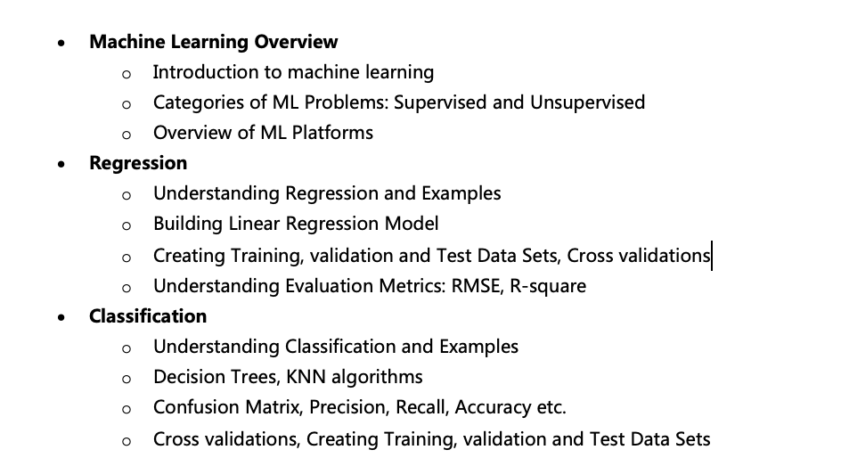
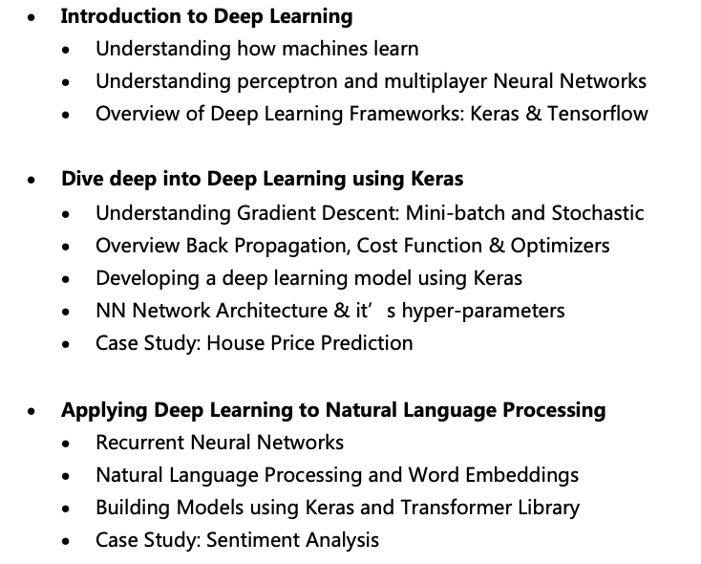
Course Outline

Slide 5
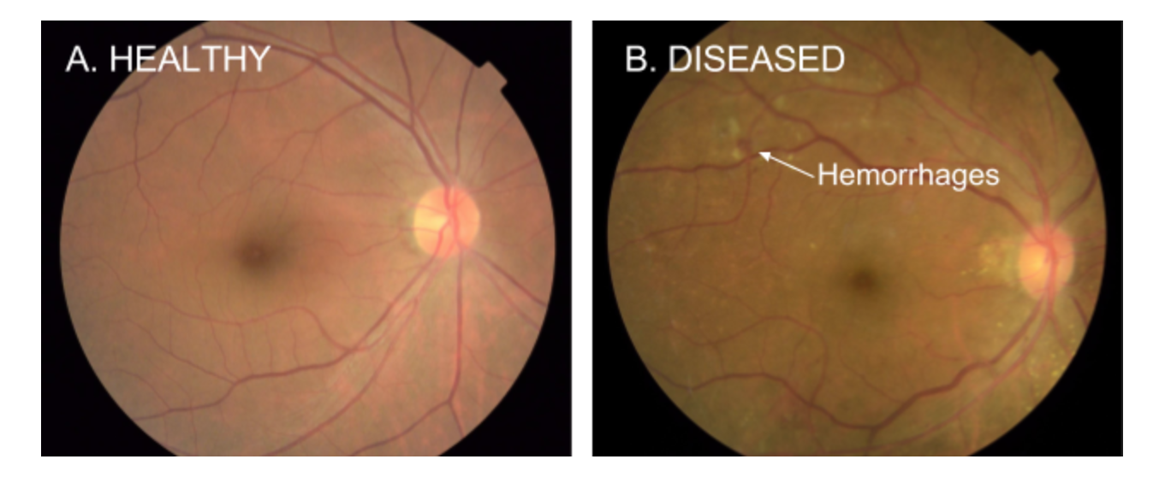
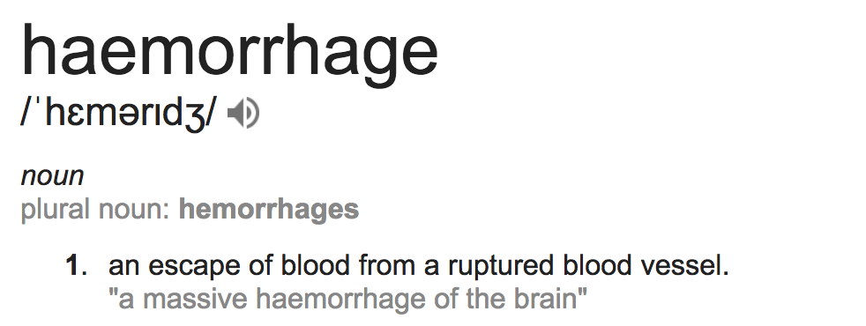
Detection of Diabetic Eye Disease
https://research.googleblog.com/2016/11/deep-learning-for-detection-of-diabetic.html
Google working closely with doctors both in India and the US, created a development dataset of 128,000 images which were each evaluated by 3-7 ophthalmologists from a panel of 54 ophthalmologists.
Trained a deep neural network to detect referable diabetic retinopathy.
Then tested the algorithm’s performance on two separate clinical validation sets totaling ~12,000 images, with the majority decision of a panel 7 or 8 U.S. board-certified ophthalmologists serving as the reference standard.
the algorithm has a F-score (combined sensitivity and specificity metric, with max=1) of 0.95, which is slightly better than the median F-score of the 8 ophthalmologists we consulted (measured at 0.91).

Slide 6
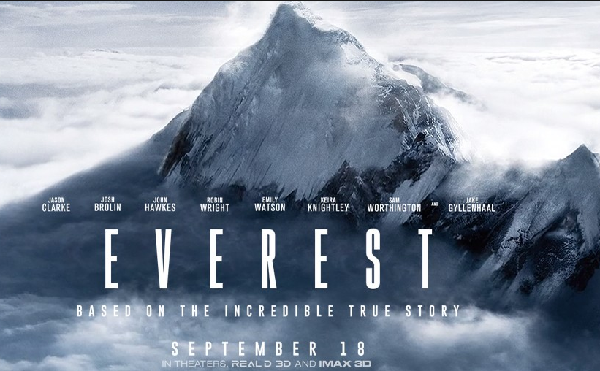
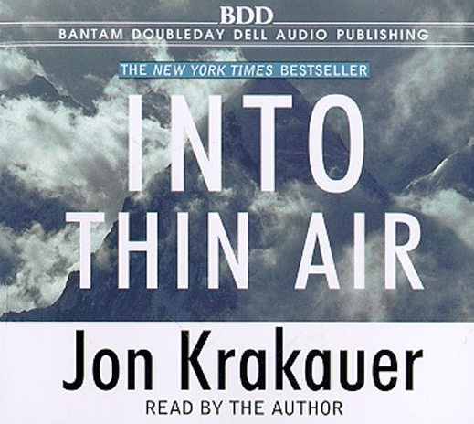
Into Thin Air
It details the author's presence at Mount Everest during the 1996 Mount Everest disaster, when eight climbers were killed and several others were stranded by a "rogue storm"

Slide 7

Touching the Void
Touching the Void is a 1988 book by Joe Simpson, recounting his and Simon Yates' successful but disastrous and nearly fatal climb of the 6,344-metre (20,813 foot) Siula Grande in the PeruvianAndes in 1985.

Slide 8
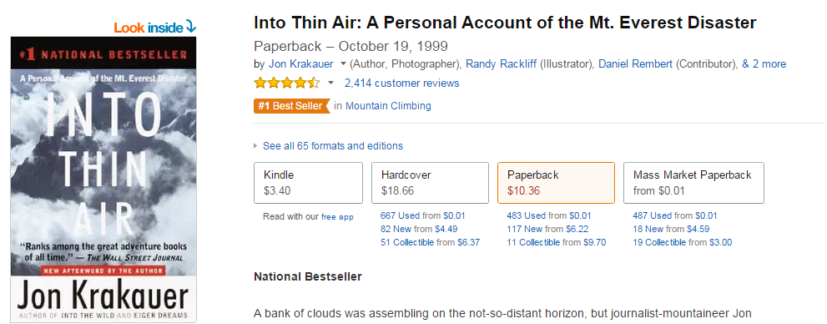

Customers who bought this item also bought…

Slide 9

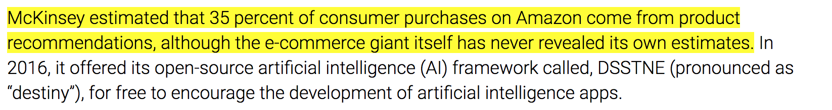
Recommendations are key to personalization
https://martechtoday.com/roi-recommendation-engines-marketing-205787

Slide 10
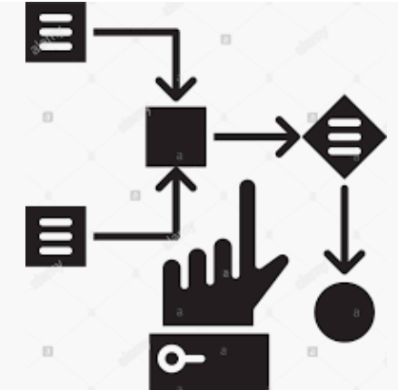
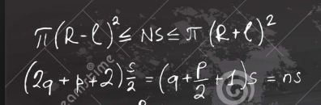
Key Components
Model
Data
Learning Algorithm
Historical Evidences
Samples representing problem scenario
Statistical Learning
Machine Learning or Deep Learning
A mathematical expression of the pattern or evidence found in data and can be used to find insights and applied in future to predict.

Slide 11
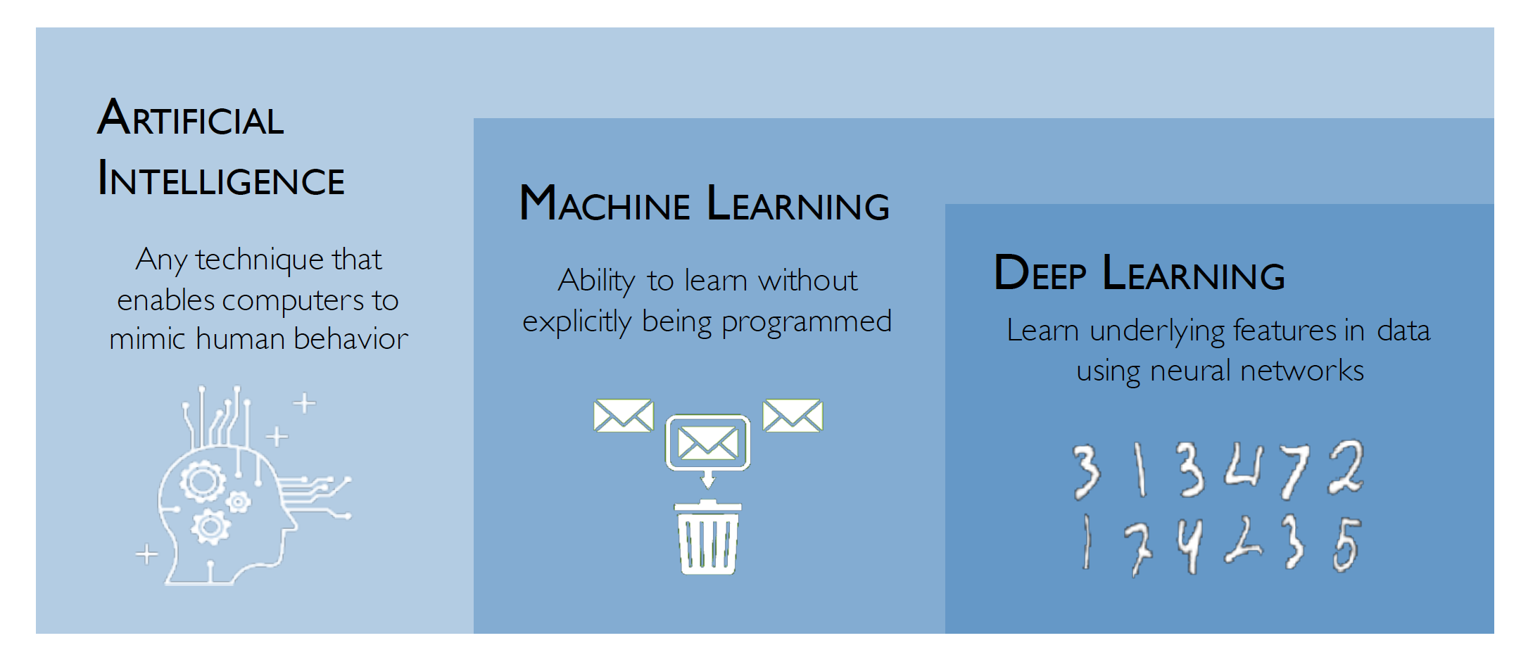
How AI, ML and DL are related?

Slide 12
Machine Learning Algorithms
Machine Learning
Ability to learn without being explicitly programmed
Supervised
Predicting customer churn, sales volume, credit card frauds, stock price movement
Unsupervised
Customer segmentation, market segmentation
Reinforcement
Learning continuously from environment
Classification
Predicting labels which are categorical for example customer churn or fraud detection
Regression
Predicting labels which are continuous in nature for example sales volume or stock price prediction.
Clustering
Grouping related items for example finding customer groups
Dimensionality Reduction
Projecting higher dimensional data onto lower dimensions. For example images
©manaranjan.pradhan

Slide 13
Lifecycle
Use Case Identification and Problem Formulation
Data Extraction and Preparation
Exploratory Analysis & Feature Engineering
Building Machine Learning Models
Model Validation and Evaluation
Model Deployment
Iterative Steps

Slide 14
What Tools are available?

Slide 15
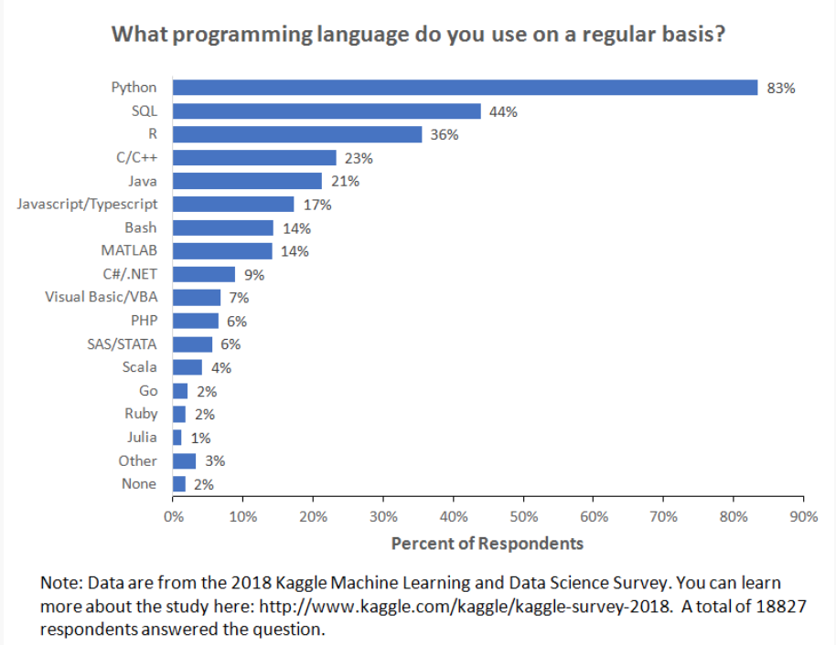
Language for Machine Learning
https://businessoverbroadway.com/2019/01/13/programming-languages-most-used-and-recommended-by-data-scientists/

Slide 16
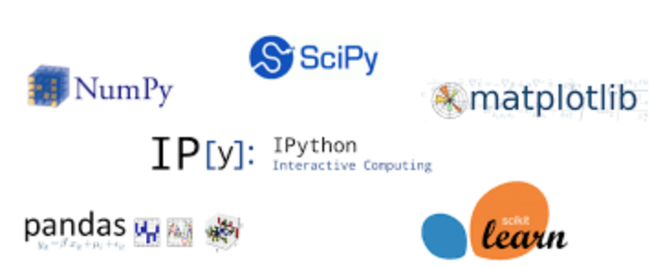

Python Stack For Data Science
Efficient storage of arrays and matrices. Backbone of all scientific calculations and algorithms.
Library for scientific computing. Linear algebra, statistical computations, optimization algorithm.
Plotting and visualization
High-performance, easy-to-use data structures for data manipulation and analysis. Pandas provide the features of dataframe, which is very popular in the area of analytics for data munging, cleaning & transformation.
Machine learning library. Collection of ML algorithms.
IDE or Development environment for data analysis in python.

